Slide 1




CHANGING THE GAME IN
ADOLESCENT-CENTERED DESIGN:
ASSETS, ACCESS, ADHERENCE
#changingthegame #AIDS2108
Please tag @grassrootsoccer

Slide 2
GRS Pre-Conference
July 22, 2018
Amsterdam
Adolescent HIV Services:
An 8 country review
Maryanne Ombija

Slide 3
Acknowledgements
Presented at INTEREST 2018 and 10th Pediatric Workshop 2018
Co-authors:
  John Ditekemena and Aime Loando - EGPAF DRC
  Patrice Tchendjou - EGPAF Cameroon
  Caspian Chouraya and Harriet Mamba – EGPAF eSwatini
  Lucy Matu and Justine Odionyi – EGPAF Kenya
  Thabiso Lekhotsa and Limpho Maoela – EGPAF Lesotho
  Allan Ahimbisibwe – EGPAF Malawi
  Roland van de Ven – EGPAF Tanzania
  Blessing Mutede and Emmanuel Tachiwenyika – EGPAF Zimbabwe

Slide 4
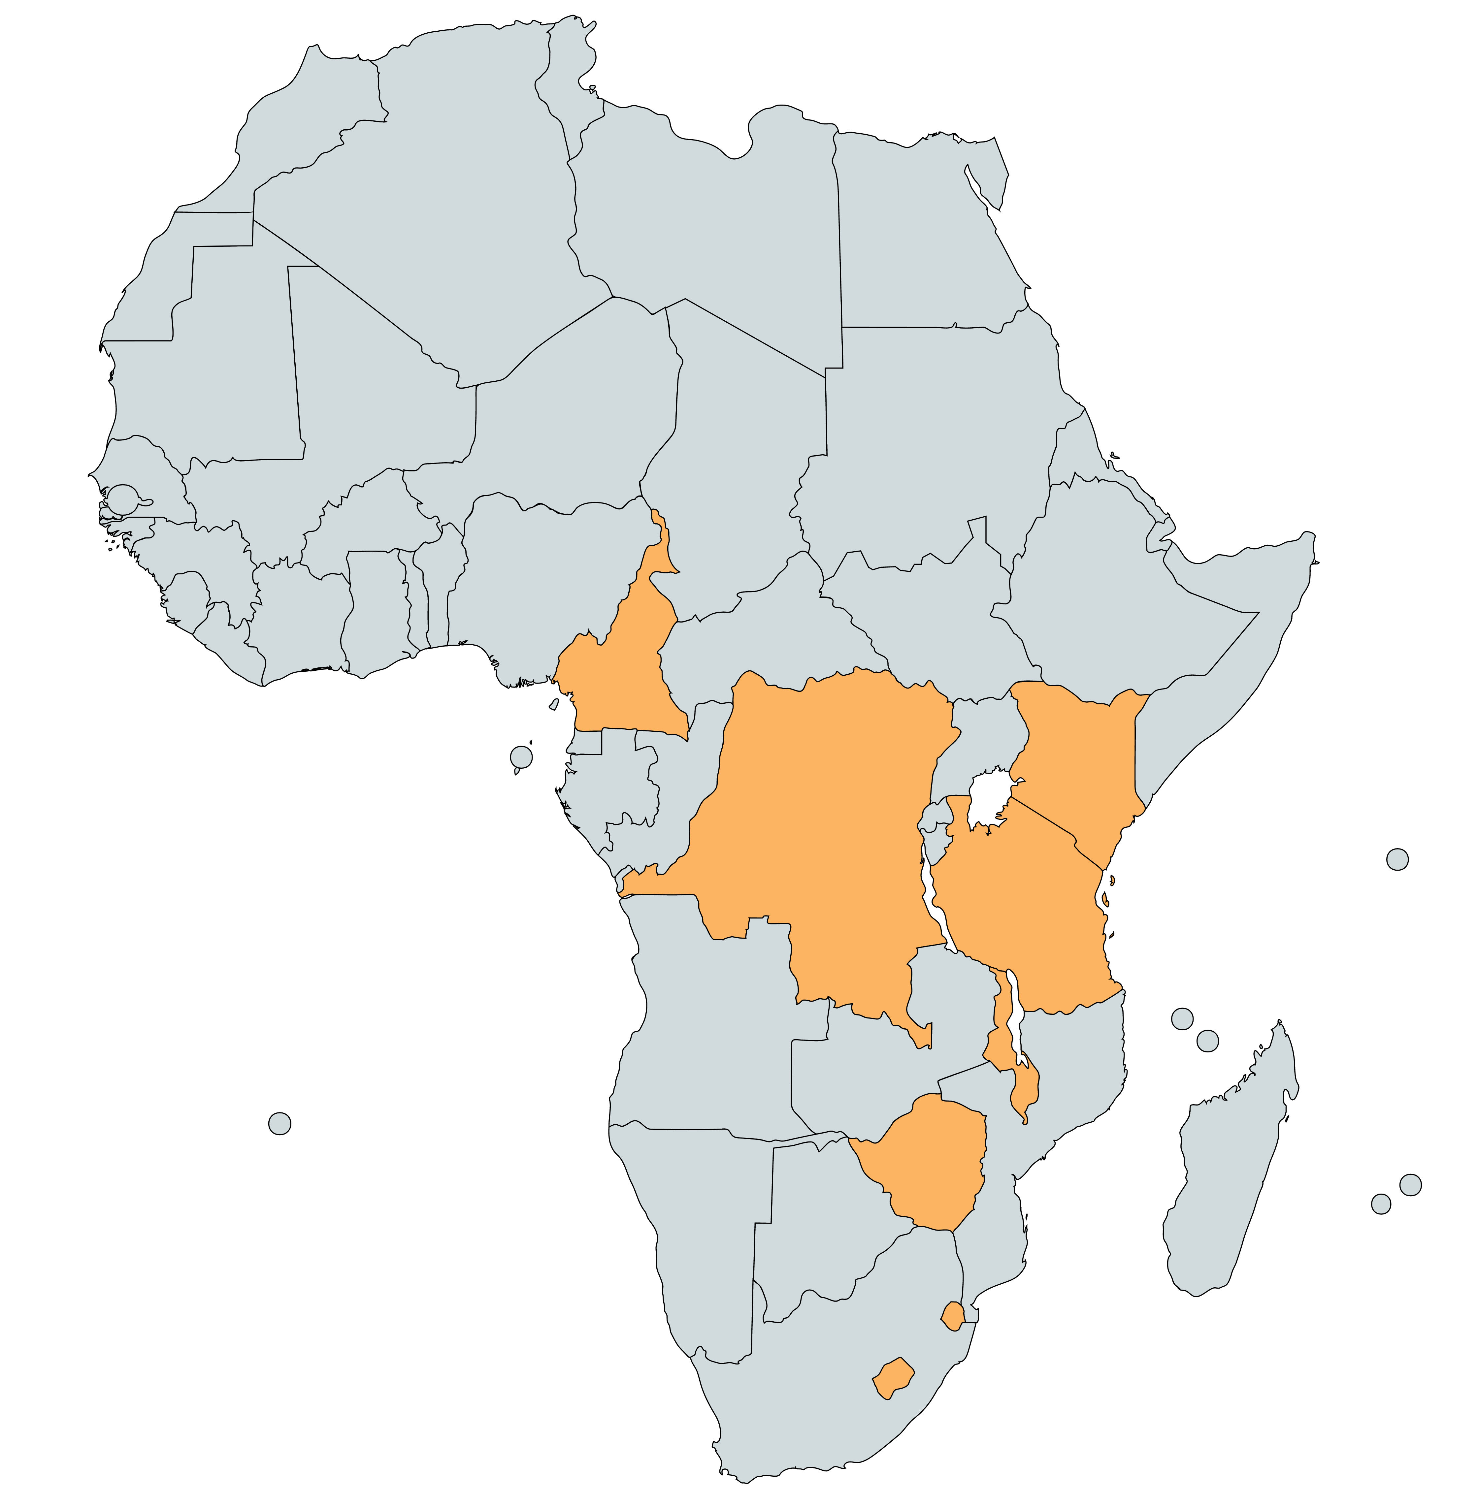



Access to ARVs for 10-19 year olds: 841 sites
DRC – 30 facilities
Cameroon – 121 facilities
Lesotho – 118 facilities
Kenya – 159 facilities
Malawi – 78 facilities
eSwatini – 56 facilities
Tanzania – 219 facilities
Zimbabwe – 60 facilities

Slide 5
Adolescents on ART at Sites
For available CDC, USAID & CIFF data using PEPFAR MER definitions
Notes:
TX curr – number of adolescents 10-19 years currently on ART as of Sept 17 at all EGPAF (country) TX_CURR Number of population currently receiving antiretroviral therapy (ART)
TX new – number of new adolescents 10-19 starting treatment as of Sept 17 at all EGPAF sites (for the country); TX_NEW Number of population newly enrolled on antiretroviral therapy over the year(ART)

Slide 6
Lessons
HIV positive adolescents represent 4-10% of total population in case
Documented 18,630 viral load tests for adolescents on treatment; HVL was not accessible to all and was especially low in DRC, Cameroon and Zimbabwe
Only 23% of adolescents on treatment attend clubs and support group as part of clinical care
More lay and professional providers completed adolescent-friendly HIV service training when provided on-site compared to off-site; especially Lesotho (1432 providers) & eSwatini (875 providers)

Slide 7

Conclusions
Rapid pace of providing universal treatment will need to anticipate unique adolescent care challenges with scale up, alongside workforce capacity and resources
Access to ART exists but lab tests for viral load remains limited, making it difficult to know the impact of access on treatment outcomes
EGPAF continues with our support of all current and future ALHIV with the aim of an AIDS-free generation

Slide 8
Thank you!
For more information: mombija@pedaids.org

Slide 9
CHANGING THE GAME IN
ADOLESCENT-CENTERED DESIGN:
ASSETS, ACCESS, ADHERENCE
#changingthegame #AIDS2108
Please tag @grassrootsoccer

